Slide 1
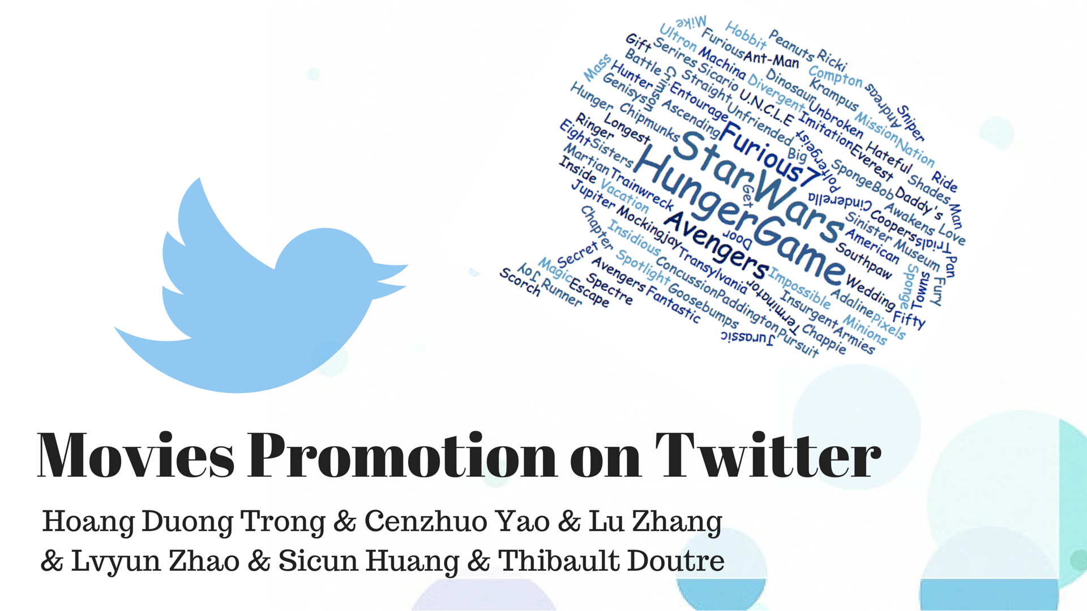

Slide 2
Intro
Plot: 2009-2015 Top 100 movies who have official Twitter accounts
No. of followers
No. of favorites
11591814
6384445
291527
8636743
No. of tweets
No. of reweets

Slide 3
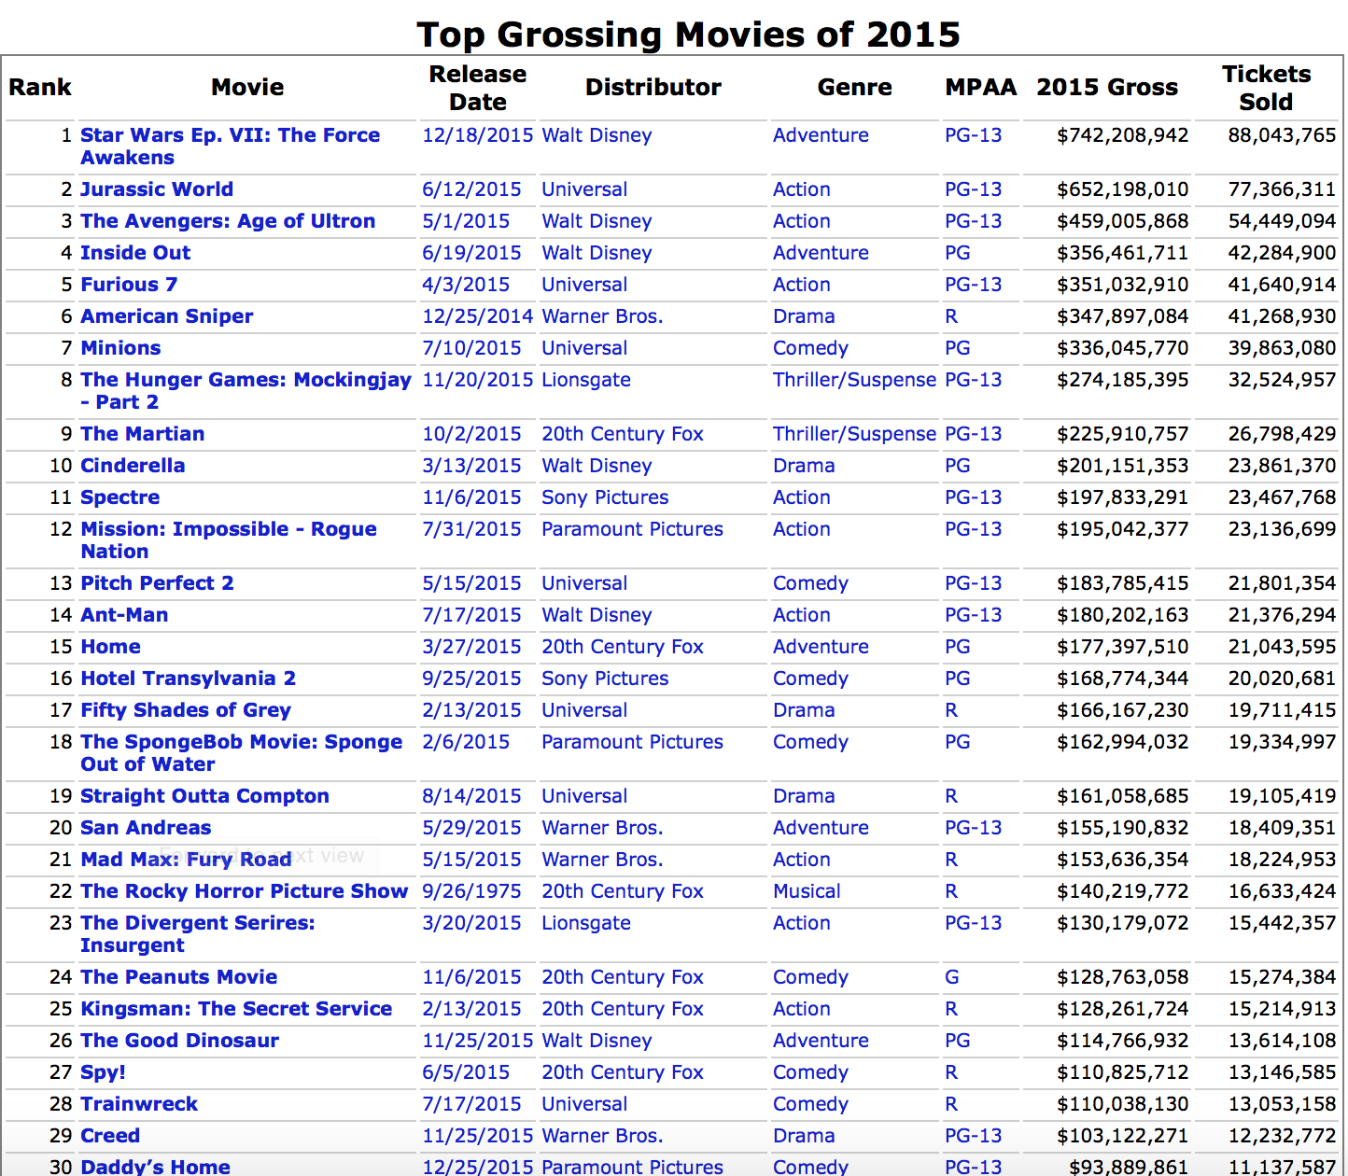

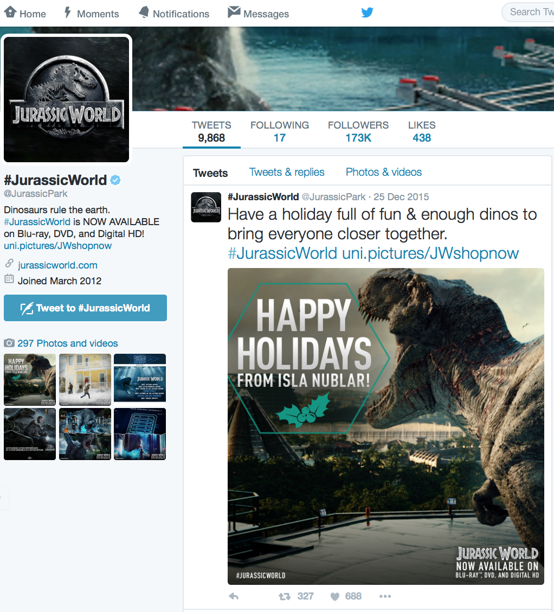
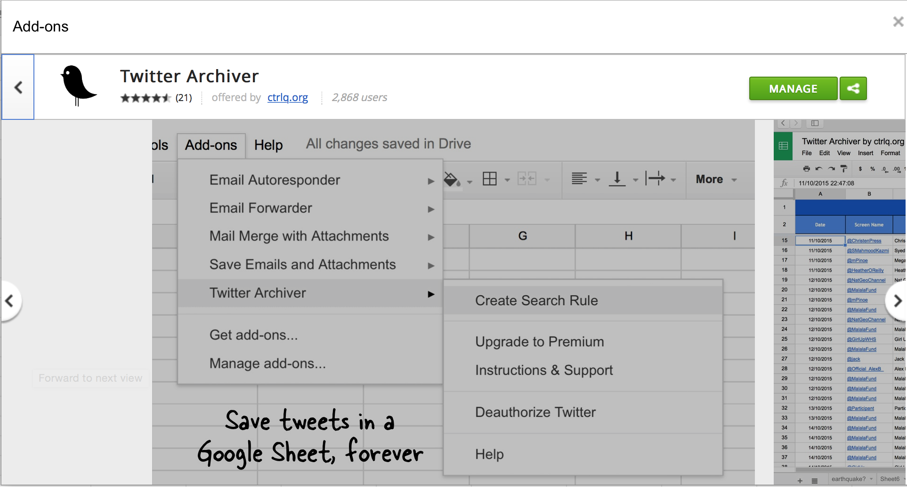
Data Source
IMDB
Movies Rating
the-numbers.com
2015 top-grossing-movies
Twitter
REST API
Twitter Archiver
Search API

Slide 4
Questions
1.
2.
3. What kind of different promotion styles do they have?
4. Public opinions about those movies

Slide 5
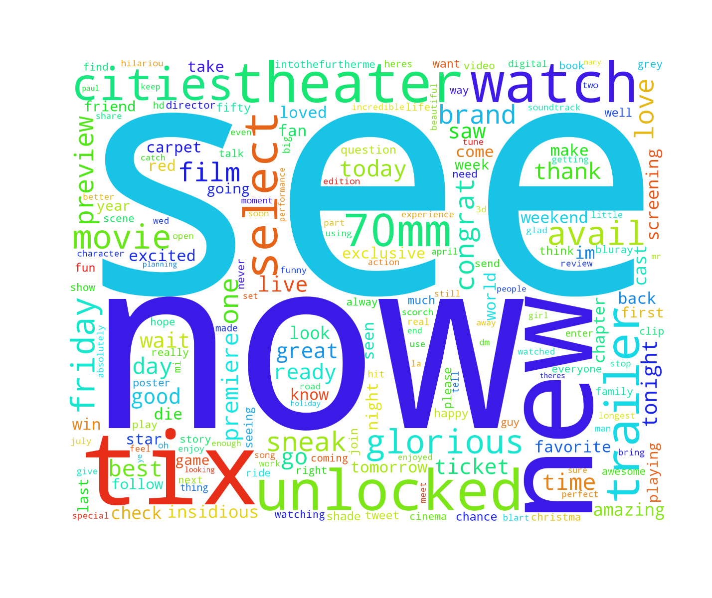
Word Cloud
Word | Frequency | Word | Frequency
see | 9150 | trailer | 3353
now | 8620 | select | 3248
new | 6852 | cities | 3145
tix | 6285 | glorious | 3118
unlocked | 5126 | avail | 3107
theaters | 4540 | friday | 3037
watch | 4195 | movie | 2700

Slide 6
Frequent Words

Slide 7
Plot: Big plot

Slide 8
Sales vs. Rating

Slide 9
What feature prompt the Sales/Rating?
Followers vs. Sales/Rating
Tweets vs. Sales/Rating

Slide 10
PCA

Slide 11
K Means

Slide 12
Outliers

Slide 13
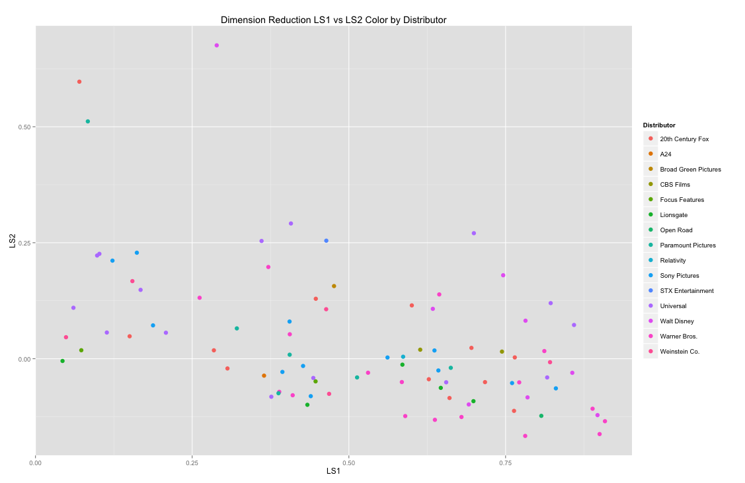
Feature: Distributors

Slide 14
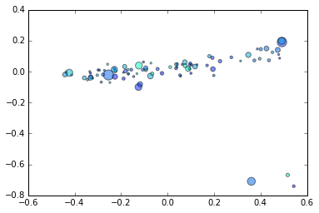
Distributors vs. Sales

Slide 15
Text sentiment analysis methods(nltk)

Slide 16
Plot: number of tweets towards release date
positive/negative words proportion

